Slide 1



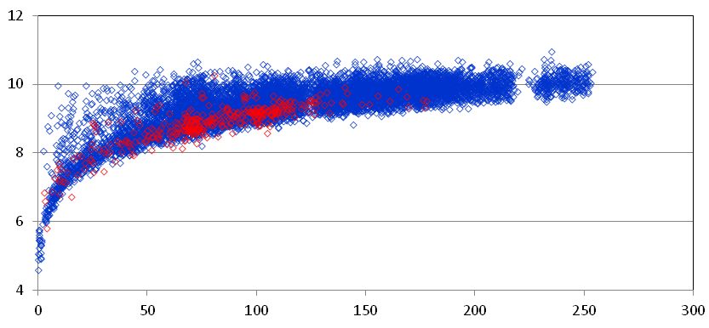
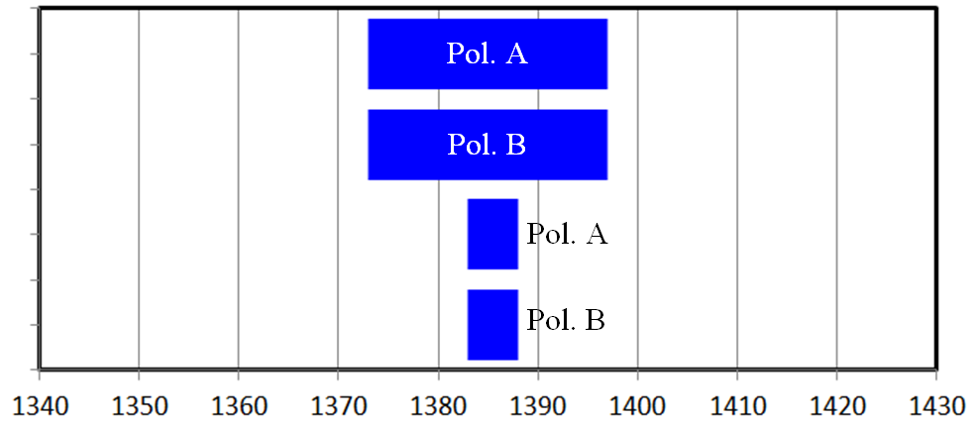
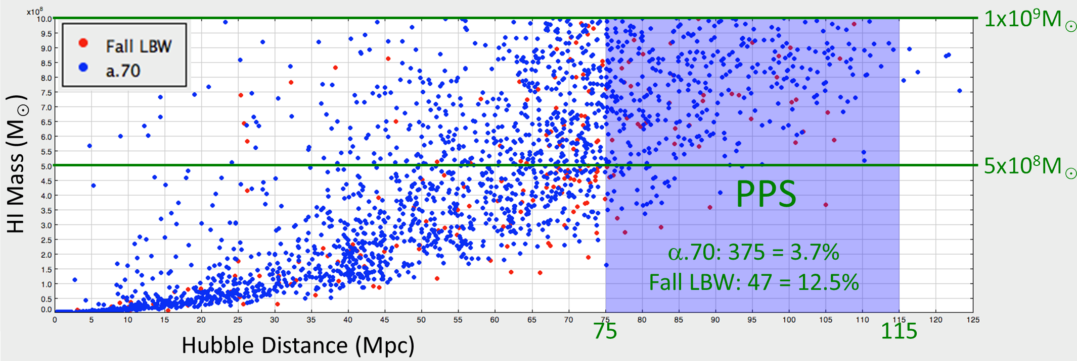
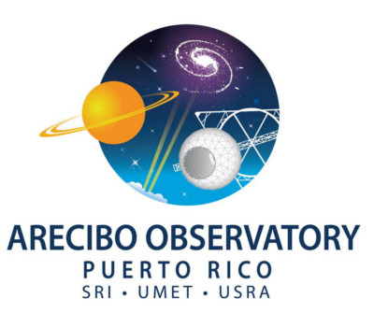

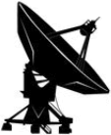
Extending ALFALFA in the Direction of the Pisces-Perseus Supercluster with the Arecibo L-Band Wide Receiver
Aileen A. O'Donoghue¹, Martha P. Haynes², Rebecca A. Koopmann³, Michael G. Jones⁴, Gregory L. Hallenbeck³, Riccardo Giovanelli², Lyle Hoffman⁵, David W. Craig⁶ and the Undergraduate ALFALFA Team
¹St. Lawrence University, ²Cornell University, ³Union College, ⁴Instituto de Astrofísica de Andalucía (IAA-CSIC), ⁵Lafayette College, ⁶West Texas A & M University
Introduction
Three “Harvesting ALFALFA” Arecibo observing programs in the direction of the Pisces-Perseus Supercluster (PPS) were completed since ALFALFA observations were finished in 2012.
Arecibo Observatory Observation Programs
Harvesting ALFALFA: L-band Wide Followup of Enigmatic ALFALFA sources II
A2707 Haynes et al. Fall 2012, Detected 35 of 128 targets (52h)
1) Confirm reality of high S/N dark galaxies
(determine which ones are OH Megamasers),
2) Identify real sources among low S/N, low z (cz < 1000 km/s), narrow velocity width (W50 < 80 km/s) candidate signals.
Harvesting ALFALFA: Reaping the 21cm Harvest in the Pisces-Perseus Supercluster and the Foreground Void
A2811 Haynes et al., Fall 2013, Detected 184 of 239 targets (42h)
1) Identify real sources among low S/N, possible OC
2) Increase number of (SDSS) galaxies with measured redshifts
Harvesting ALFALFA: Discovering Galaxies in the Pisces-Perseus Void
A2899 Koopmann et al., Fall 2014, Det. 167 of 218 targets (40h)
1) Use ALFALFA, SDSS & GALEX to investigate galaxies in & around the PPS Void to test formation & evolution models in low density regions,
2) Increase number of (SDSS) galaxies with measured redshifts
3) Identify real sources among low S/N, possible OC
Table 1: ALFALFA Selected Targets
Selected from | A2707 |  | A2811 |  | A2899 |  | Det. Rate (%)
 | Det. | NoDet. | Det. | NoDet. | Det. | NoDet.
High S/N | 27 | 4 | 3 | 0 | -- | -- | 88.2
Low S/N + OC | 5 | 4 | 133 | 57 | 77 | 29 | 70.5
Low S/N no OC | 0 | 82 | -- | -- | 0 | 1 | 0.0
Totals | 32 | 90 | 136 | 57 | 77 | 30 | 58.0
Det. Rate (%) | 26.2 |  | 70.0 |  | 72.0
Table 2: SDSS Selected Targets
Selected from | A2707 |  | A2811 |  | A2899 |  | Det. Rate (%)
 | Det. | NoDet. | Det. | NoDet. | Det. | NoDet.
Photometry | 0 | 2 | 24 | 4 | 61 | 18 | 78.7
Known z | -- | -- | -- | -- | 8 | 1 | 88.9
Totals | 0 | 2 | 24 | 4 | 69 | 19 | 78.8
Det. Rate (%) | 0.0 |  | 85.7 |  | 78.4
Arecibo Legacy Fast ALFA¹ Survey
Blind extragalactic neutral hydrogen (HI) spectral line survey covering 7,000 square degrees of the sky. Observing in frequencies between 1,345 MHz and 1,435 MHz allowed detection of HI source velocities of -3,000 km/s to +19,200 km/s with 5 km/s resolution
at a Hubble distance of 270 Mpc, z ≤ 0.06. Observations began on February 4, 2005 and were completed on October 26, 2012.
40% of the data were released in 2011 (α.40, Haynes et al., 2011), 70% in 2015 and the preliminary release of α.100, has begun at http://egg.astro.cornell.edu/alfalfa/data/.
¹ Arecibo L-band Feed Array
Results and Conclusions
A small % of high S/N ALFALFA sources are spurious
Consistent with simulations of reliability (Saintonge, 2007) and cut-off adopted (S/N > 6.5)
Majority of high S/N galaxies without an OC are real
Some are tidal remnants, some “almost dark” galaxies
See Leisman Dissertation Talk 132.06
Low S/N “minihalo” candidates (cz < 1,000 km/s, W50 < 80 km/s) lacking an OC are spurious (Giovanelli et al., 2010)
Detected 0 of 83 … yes, ZERO
Finding one would have been very interesting! Oh, well …
Low S/N ALFALFA sources with OCs are likely to be real
Detected 215 of 305 (undetected likely to be spurious)
Pointed LBW observations can detect lower HI mass galaxies filling in low end of the HI Mass Function
Only way to sample more galaxies in local universe
LBW targets can be successfully selected by photometric criteria and ranges defined in SQL queries
85 more SDSS galaxies now have measured redshfits
Technique adopted for the APPS Survey; See Davis et al. Poster 347.40 and Craig et al. Abstract 132.03.
Pisces-Perseus Supercluster
PPS is the nearest supercluster to Milky Way Galaxy beyond Laniakea. (Tully et al., 2014) . We seek to explore the distribution and peculiar velocities of galaxies and clusters to determine the underlying distribution of dark matter in the large scale structures of the universe.
PPS has been found to be
wall of clusters roughly 5h⁻¹ Mpc to 10h⁻¹ Mpc deep
extending at least 50h⁻¹ Mpc from the Perseus to Pegasus
with a significant overdensity of galaxies at a heliocentric
velocity of about 5,000 km/s. (Wegner et al., 1993)
between foreground and background voids.
All of which allow more accurate determinations of infall velocities of galaxies on each side of the main ridge of the supercluster.
At the distance of PPS,
4% of α.70 sources (in blue below) have M_{HI} < 10⁹ M☉
12.5% of Fall LBW detections (in red) have M_{HI} < 10⁹ M☉
The Fall LBW observations have thus paved the way for the Arecibo Pisces-Perseus Supercluster Survey (APPS). See Davis et al. Poster 347.40 and Craig et al. Abstract 132.03.
HI Mass Function
Log M_{HI}
◊ LBW Fall Detections
◊ a.70 Fall Detections
Distance (Mpc)
Targets & Detections
ALFALFA sources classified according to
signal-to-noise ratio (S/N) and
High S/N sources (> 6.5) have a 95% confidence level
some that lack an OC may be spurious
presence of an optical counterpart (OC).
Low S/N (4.5 < S/N < 6.5) sources with an OC ⇒ real?
Low S/N sources lacking an OC ⇒ spurious?
Sloan Digital Sky Survey (SDSS) sources selected
galaxies not detected by ALFALFA similar to OCs
SQL query to find galaxies likely to be at distance of PPS.
Observation Method
Pointed basic Total-Power Position-Switched Spectral Observations in 1340 – 1430 MHz ALFALFA frequency range.
3 minutes on source, return to original position
3 minutes on blank sky along same altitude-azimuth path
Arecibo Interim Correlator bands centered on source frequency
2 low-resolution spectra (1/pol))
2048 channels across 25 MHz
2 high-resolution spectra (1/pol)
2048 channels across 6.25 MHz
9-level sampling
Interim Correlator Spectra for v_{heliocentric} = 7,600 km/s centered at 1,385 MHz.
Acknowledgements
We are grateful for the contributions of all members of the Undergraduate ALFALFA Team. This work has been supported by NSF grants AST-1211005, AST-1637339 and AST-1637271. The Cornell ALFLAFA Team also appreciates support from NSF/AST-1107390 and the Brinson Foundation. The Arecibo Observatory is operated by SRI International under a cooperative agreement with the National Science Foundation (AST-1100968), and in alliance with Ana G. Méndez-Universidad Metropolitana, and the Universities Space Research Association.
References
Haynes, M. P., Giovanelli, R., Martin, A., et al. 2011, ApJ, 741, 124
Giovanelli, R., et al. 2010, ApJL, 708, L22
Saintonge, A., 2007, AJ, 133, 2087
Tully, R. B., Courtois, H., Hoffman, Y., & Pomarède, D. 2014, Nature, 513, 71
Wegner, G., Haynes, M. P., & Giovanelli, R., 1993, AJ, 105, 1251

